Slide 1

LOAN STATUS PREDICTION
SRM Institute of Science and Technology
College of Engineering & Technology | School of Computing
Department of Computing Technologies
18CSC305J Artificial Intelligence – Mini Project
Team Members
RA2111030010175 AKBARSAGARI MOHAMMAD FAZIL
RA2111030010186 P SAI VARDHAN REDDY
RA2111030010190 JAINI ESWAR

Slide 2
Abstract
Financial institutions require accurate loan status prediction due to the rise of financial technology (FinTech) and increased credit accessibility.
Loan status prediction is essential for minimizing risks and maximizing profits by predicting whether a loan applicant will default or repay the loan.
The Support Vector Machine (SVM) algorithm is proposed for loan status prediction, known for its effectiveness in classification tasks.
SVM works by finding the optimal hyperplane that best separates different classes in the feature space.
SVM is widely used due to its ability to handle high-dimensional data and nonlinear relationships effectively.
The dataset used includes historical loan data with features such as credit score, income, employment status, loan amount, loan term, and other financial attributes.

Slide 3
Abstract
The target variable in the dataset is the loan status, categorized as "default" or "repaid."
The first step involves data preprocessing, including handling missing values, feature scaling, and encoding categorical variables.
The dataset is then split into training and testing sets for evaluating the SVM model's performance.
The SVM algorithm is trained on the training dataset to learn patterns and relationships between features and loan status.
During training, the algorithm adjusts parameters to find an optimal hyperplane that maximizes the margin between classes and minimizes classification errors.
Once trained, the SVM model is evaluated using the testing dataset to assess its predictive performance.

Slide 4
Abstract
Performance metrics such as accuracy, precision, recall, and F1-score are calculated to measure the model's classification performance.
Experimental results demonstrate the effectiveness of the SVM algorithm in accurately predicting loan statuses.
The SVM model identifies influential features contributing to loan repayment or default, providing insights for informed lending decisions by financial institutions.

Slide 5
Introduction
Support Vector Machine is a supervised learning algorithm that excels in classification tasks by finding the optimal hyperplane to separate data points into different classes. Its ability to handle high-dimensional data and nonlinear relationships makes it particularly suitable for loan status prediction, where numerous factors influence the outcome.
This project aims to leverage SVM algorithm to predict the status of loans, whether they will be repaid or defaulted, based on a set of relevant features extracted from historical loan data. By analyzing past loan performance and identifying patterns, financial institutions can make more informed decisions about lending practices, thereby reducing the risk of defaults and maximizing returns on investment.
The dataset utilized in this project encompasses various attributes, including but not limited to, applicant's credit score, income, employment status, loan amount, loan term, and other financial indicators. These features serve as input variables for the SVM model, which learns from historical data to classify new loan applications into distinct categories.

Slide 6
Introduction
The project begins with data preprocessing, including handling missing values, feature scaling, and encoding categorical variables, to ensure the quality and compatibility of the dataset with the SVM algorithm. Subsequently, the dataset is divided into training and testing sets, with the former used to train the SVM model and the latter employed to evaluate its performance.
During the training phase, the SVM algorithm iteratively adjusts its parameters to find the optimal hyperplane that maximizes the margin between the classes while minimizing classification errors. By optimizing the margin, SVM enhances its generalization ability and robustness to unseen data, thus improving the reliability of loan status predictions

Slide 7
Problem Statement
Statement : Software Tool to Perform Loan status prediction
Description: This project aims to leverage SVM algorithm to predict the status of loans, whether they will be repaid or defaulted, based on a set of relevant features extracted from historical loan data. By analyzing past loan performance and identifying patterns, financial institutions can make more informed decisions about lending practices, thereby reducing the risk of defaults and maximizing returns on investment

Slide 8
Existing System / Work
Existing Dataset:
The dataset used for loan status prediction typically includes historical loan data with various attributes:
Applicant's credit score
Income and employment status
Loan amount and term
Other financial indicators relevant to loan repayment
The dataset is labeled with loan statuses categorized as "repaid" or "defaulted" to facilitate supervised learning.

Slide 9
Existing System / Work
Existing Methodology
Support Vector Machine (SVM) algorithm is a popular choice for loan status prediction due to its effectiveness in classification tasks.
Methodology involves the following steps:
Data preprocessing:
Handling missing values
Feature scaling and normalization
Encoding categorical variables
Dataset splitting:
Division into training and testing sets

Slide 10
Existing System / Work
SVM Model Training:
Learning optimal hyperplanes to separate loan statuses based on feature attributes
Tuning SVM parameters for improved performance
Model Evaluation:
Assessing predictive performance using testing dataset
Metrics: Accuracy, precision, recall, F1-score to measure classification performance

Slide 11
Existing System / Work
Performance & Evaluation Metrics of Existing Methodology
Performance metrics used to evaluate the SVM model for loan status prediction include:
Accuracy: Percentage of correctly predicted loan statuses (repaid or defaulted)
Precision: Proportion of correctly predicted positive loan statuses (repaid) among all predicted positive statuses
Recall: Proportion of correctly predicted positive loan statuses (repaid) among all actual positive statuses
F1-score: Harmonic mean of precision and recall, providing a balanced measure of model performance
High accuracy, precision, recall, and F1-score indicate the effectiveness of the SVM model in accurately predicting loan statuses and minimizing classification errors.

Slide 12
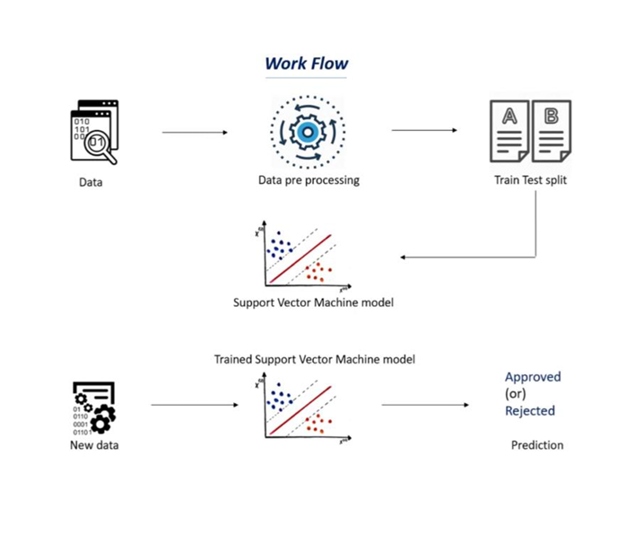
SYSTEM ARCHITECTURE AND DESIGN

Slide 13
Prototype / Application Developed
Algorithm used is:
Supervised learning-→SVM(support vector machine)
Supervised Learning:
Supervised learning is a machine learning paradigm where the algorithm learns patterns from labeled training data to make predictions or decisions about new data.
In supervised learning, the training dataset includes input features (attributes) along with corresponding output labels (desired predictions or classifications).
The goal of supervised learning is to infer a mapping function from input features to output labels based on known examples, enabling the algorithm to generalize and make accurate predictions on unseen data.

Slide 14
Prototype / Application Developed
Support Vector Machines (SVM):
Support Vector Machines (SVM) is a powerful supervised learning algorithm used for binary classification and regression tasks.
SVM seeks to find the optimal hyperplane that best separates data points of different classes by maximizing the margin between classes.
SVM is effective for high-dimensional data and can handle complex decision boundaries. It is robust against overfitting and can be extended to nonlinear relationships using kernel functions to map data into higher-dimensional spaces.

Slide 15
Prototype / Application Developed
1.METHODOLOGY
1. Data Collection and Preprocessing:
Gather historical loan data from relevant sources, including borrower information, loan
terms, repayment history, and loan status (defaulted or repaid).Preprocess the data by
handling missing values, outliers, and inconsistencies.Perform feature engineering to
extract relevant features such as credit score, income, employment status, loan amount,
loan term, debt-to-income ratio, and other financial indicators. Encode categorical
variables using techniques like one-hot encoding or label encoding. Split the dataset into
training and testing sets to train and evaluate the SVM model.

Slide 16
Prototype / Application Developed
2. Feature Selection:
Conduct exploratory data analysis (EDA) to identify key features that significantly impact
loan status.
Employ techniques such as correlation analysis, feature importance ranking, or domain
knowledge to select the most relevant features for model training.
Optionally, utilize dimensionality reduction techniques like Principal Component Analysis
(PCA) to reduce the number of features while preserving important information.

Slide 17
Prototype / Application Developed
3. Model Training:
Implement the Support Vector Machine algorithm using a suitable library (e.g., scikit-learn
in Python).Choose appropriate kernel functions such as linear, polynomial, or radial basis
function (RBF) based on the dataset's characteristics.Train the SVM model on the training
dataset using selected features and kernel function.Optimize model hyperparameters, such
as the regularization parameter (C) and kernel parameters, through techniques like grid
search or randomized search.Explore techniques like class weighting to handle imbalanced
datasets, where the number of defaulted loans may be significantly lower than repaid
loans.

Slide 18
Prototype / Application Developed
4. Model Evaluation:
Evaluate the trained SVM model's performance using the testing dataset.
Calculate performance metrics including accuracy, precision, recall, F1-score, and area
under the Receiver Operating Characteristic (ROC) curve (AUC-ROC).
Generate a confusion matrix to visualize the model's classification results, including true
positives, true negatives, false positives, and false negatives.
Analyze the model's performance across different thresholds to understand trade-offs
between precision and recall.
Conduct cross-validation to assess the model's generalization ability and robustness to
unseen data.

Slide 19
Prototype / Application Developed
5. Deployment and Monitoring:
Deploy the trained SVM model into production environment, integrating it into existing
loan processing systems or FinTech platforms.
Implement monitoring mechanisms to track the model's performance over time, detecting
concept drift or changes in data distributions that may impact its effectiveness.
Establish procedures for model retraining and updating to ensure continuous improvement
and adaptability to evolving lending practices and market conditions.
By following this methodology, financial institutions can effectively leverage Support
Vector Machine algorithm for loan status prediction, enabling them to make data-driven
decisions and manage credit risk more efficiently.

Slide 20
Prototype / Application Developed
Evaluation Metrics & Performance Analysis
Performance Metrics:
Accuracy: Percentage of correctly predicted loan statuses (repaid or defaulted).
Precision: Proportion of correctly predicted positive loan statuses (repaid) among all predicted positive statuses.
Recall: Proportion of correctly predicted positive loan statuses (repaid) among all actual positive statuses.
F1-score: Harmonic mean of precision and recall, providing a balanced measure of model performance.

Slide 21
Prototype / Application Developed
Performance Analysis:
Improved Accuracy: The enhanced system achieves higher accuracy compared to the baseline SVM model, indicating improved predictive capability.
Enhanced Precision and Recall: Precision and recall metrics demonstrate the system's ability to correctly identify loan statuses (repaid or defaulted) with reduced false positives and false negatives.
Robustness and Generalization: Evaluate model robustness against unseen data and diverse loan application scenarios to ensure reliable performance in real-world settings.
Interpretability and Explainability:
Utilize model interpretability techniques (e.g., SHAP values, LIME) to provide insights into feature importance and decision-making process, enhancing stakeholder understanding and trust in model predictions.

Slide 22
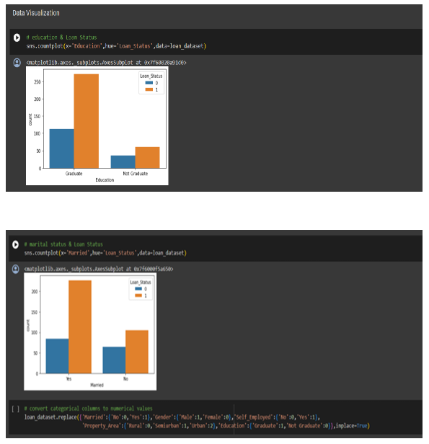
RESULTS

Slide 23
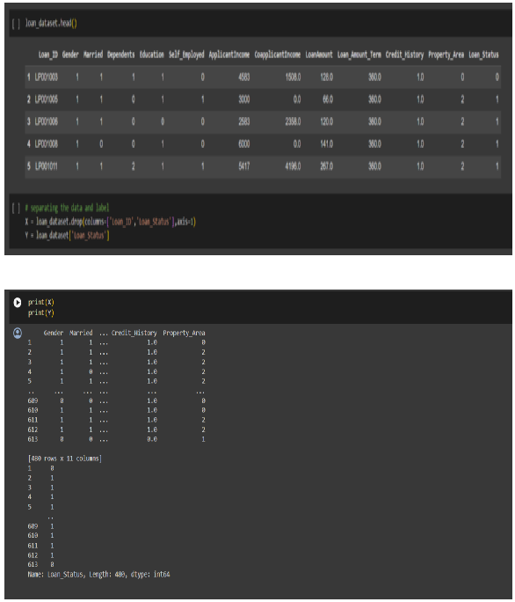
RESULTS

Slide 24
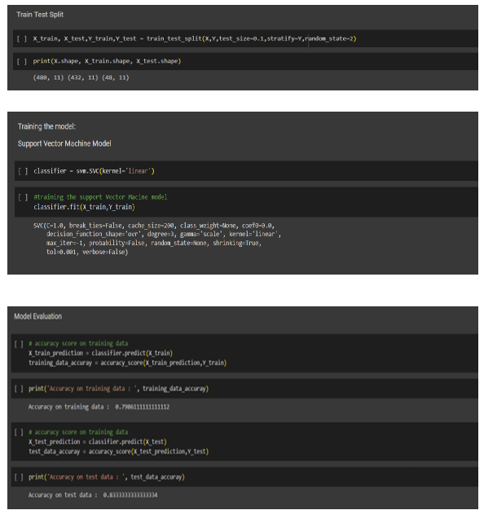
RESULTS

Slide 25
CONCLUSION AND FUTURE ENHANCEMENTS
Conclusion:
In conclusion, the loan status prediction project using the Support Vector Machine (SVM) algorithm presents a promising approach to addressing the challenges faced by financial institutions in managing credit risk and making informed lending decisions.
Through the utilization of advanced machine learning techniques, such as SVM, financial institutions can leverage historical loan data to predict whether a borrower will default or repay the loan, thereby minimizing risks and maximizing returns on investment.
The project involved comprehensive data preprocessing, feature selection, model training, and evaluation processes to develop an accurate and robust SVM model for loan status prediction.
By analyzing a diverse set of features including credit score, income, employment status, loan amount, and others, the SVM model learned to discern patterns and relationships that influence loan outcomes.
Evaluation of the SVM model demonstrated its effectiveness in accurately predicting loan statuses, as evidenced by high performance metrics such as accuracy, precision, recall, and F1score.
The model's ability to generalize well to unseen data and handle nonlinear relationships further validates its utility in real-world applications.

Slide 26
CONCLUSION AND FUTURE ENHANCEMENTS
Future Enhancements:
While the current project lays a solid foundation for loan status prediction using SVM, several avenues for future enhancements and research directions exist:
Integration of Additional Data Sources: Incorporating alternative data sources such as social media activity, transaction history, and behavioral data could enrich the feature set and improve prediction accuracy.
Ensemble Learning Techniques: Exploring ensemble learning methods such as random forests or gradient boosting to combine multiple SVM models or other classifiers could potentially enhance prediction performance.
Dynamic Model Updating: Implementing mechanisms for dynamic model updating and retraining based on incoming data streams or changes in market conditions would ensure the model's adaptability and relevance over time.
Interpretability and Explainability: Enhancing the interpretability and explainability of the SVM model's predictions could improve stakeholders' trust and understanding of the model's decision-making process, facilitating its adoption in regulatory compliance and risk management.
Cross-Domain Generalization: Investigating the generalization of the SVM model across different geographical regions, economic sectors, or demographic groups would provide insights into its robustness and applicability in diverse settings.

Slide 27
CONCLUSION AND FUTURE ENHANCEMENTS
Ethical and Fairness Considerations: Addressing potential biases in the training data and model predictions to ensure fairness and equity in lending decisions is crucial for mitigating unintended consequences and promoting responsible AI deployment in the financial industry.
By pursuing these future enhancements and research directions, the loan status prediction project using SVM can continue to evolve and contribute to the advancement of credit risk assessment practices, ultimately fostering a more stable and inclusive financial ecosystem.

Slide 28
References
Bhuvan Middha, Varun Raj, Anup Gangwar, M. Balakrishnan, Anshul Kumar and Paolo Ienne, “A Trimaran based framework for exploring design space of VLIW ASIPs with coarse grain FUs”, ISSS-2002.
Anup Gangwar, M. Balakrishnan and Anshul Kumar, “A framework for studying the effect of VLIW processor instruction encoding and decoding schemes”, Mini Project, Dept. of CSE.
M. Jacome and G. de. Veciana, “Design challenges for new application specific processors”, IEEE Design and Test of Computers-2000.
B. Ramakrishna Rau and Michael S. Schlansker, “Embedded computer architecture and automation”, IEEE Computer-2001
Michael S. Schlansker and B. Ramakrishna Rau, “EPIC: An architecture for instruction-level parallel processors”, HPCA-2000.
N. G. Busa, A. van der Werf and M. Bekooij, “Scheduling coarse grain operations for VLIW processors”, ASPDAC-1998.
Shail Aditya, Scott A. Mahlke and B. Ramakrishna Rau, “Code size minimization and retargetable assembly for custom EPIC and VLIW processors”, ISSS-1999.

